Slide 1
CS 4032 – Web Programming
Dr. Hassan Sartaj

Slide 2
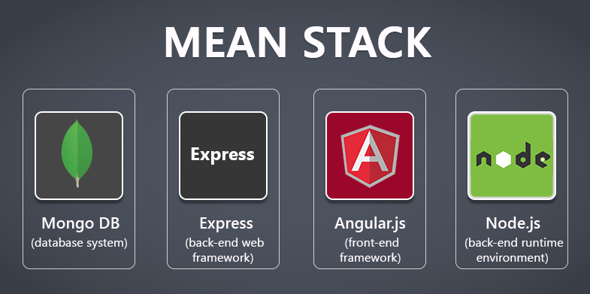
Collection of JavaScript based technologies used to develop web applications.

Slide 3
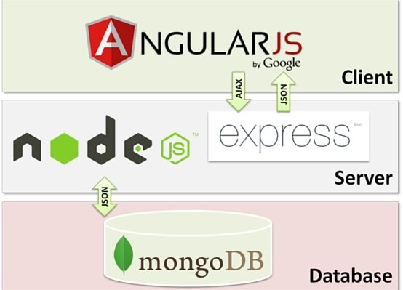
MEAN
M = MongoDB
E = Express
A = Angular.js
N = Node.js

Slide 4
Setting up MEAN Development Environment
MongoDB
Download the latest MongoDB Community Server from MongoDB, and follow the installation guide for your platform (e.g. Windows, MacOS, Ubuntu).
Node.js and NPM Packages
Download and install Node.js 16.x from nodejs.org. We will also need the following global packages:
express-generator for creating web applications using the Express framework.
@angular/cli for creating and building Angular projects.
nodemon for running and monitoring Node.js applications.
To install a package globally (meaning the package will be available to all projects instead of being used by only one project), open a command prompt and run the following command:
npm install -g <package_name> : For example, to install nodemon, simply run "npm install -g nodemon".
Text Editors for Developers
Sublime Text, Visual Studio Code, and Atom are all great code editors and popular among MEAN stack developers. Just pick one that you like the most

Slide 5

Angular
Client Side Application Framework

Slide 6
Introduction
Angular is an open-source web application framework
Based on TypeScript
Mainly maintained by
Google
Community of individuals and corporations
Simplified front-end Development
One platform for Desktop & Mobiles
Address many of the challenges encountered in developing single-page applications
Useful as structural framework for dynamic web apps

Slide 7
Angular: An Application Framework for the Client-Side
Single Page
Application (SPA)
RESTful
Web
Service
Mobile
Application
Desktop
Application

Slide 8
Angular CLI
A command-line tool to create, build, and run Angular applications
For Installation
npm install -g @angular/cli
For Creating Project
ng new <proj>
For run the app
ng serve --open

Slide 9
Angular - TypeScript

Slide 10
TypeScript
TypeScript
ES7 (ES2016)
ES6 (ES2015)
ES5
JavaScript with Type
Makes JavaScript more suitable for large software projects
Static type checking, improved tool support …
Developed by Microsoft
Can be compiled into plain JavaScript
Notes:
ECMAScript is a subset of JavaScript. JavaScript is basically ECMAScript at its core but builds upon it
ECMAScript specification. ES6, ES7,… E8

Slide 11
Compile and Run TypeScript
Install NPM package typescript
npm install -g typescript
Use tsc to compile .ts files to .js
Install NPM package ts-node
Use ts-node to run .ts files directly

Slide 12
ES6 and ES7 Features
Class (ES6 and ES7)
Decorators (ES7)
Configurable decorators
Module (ES6)
Notes:
ECMAScript is a subset of JavaScript. JavaScript is basically ECMAScript at its core but builds upon it
ECMAScript specification. ES6, ES7,… E8

Slide 13
Class Example
Constructor
Static and instance properties
Static and instance initializers
Static and instance methods
Inheritance

Slide 14
Decorators
@Component({
selector: 'app-root',
templateUrl: './app.component.html',
styleUrls: ['./app.component.css']})
Similar to annotations in Java
Add metadata and/or behavior
Types of decorators: class, property, method, and parameter

Slide 15
Class Decorator Example
A class decorator is a function with one argument: the class (or more accurately, the constructor function)
A configurable decorator is a function that takes a config object and returns a regular decorator function
Enable experimentalDecorators option in tsconfig.json or on command line
For Example
@log('hello’)
class World {
}
Notes:
In the example log is invoked using @, and passed a string as a parameter, @log() returns an anonymous function that is the actual decorator.
The decorator function takes a class, or constructor function (ES5) as an argument. The decorator function then returns a new class construction function that is used whenever World is instantiated.
This decorator does nothing other than log out its given parameter, and its target's class name to the console.

Slide 16
TypeScript-Specific Features
Types and type inference
Classes and interfaces
Optional properties
Access modifiers
Abstract class
Interface
Generics
Notes:
Let see various features specific to TypeScript

Slide 17
Basic Types
Primitive types
string
number
boolean
null
undefined
Object types
String
Number
Boolean
Primitive types are automatically converted to object types when necessary

Slide 18
Type Declaration
function factorial(n: number): number {
if (n < 0) throw new Error('Invalid argument');
let result: number = 1;
for (let i: number = 1; i <= n; ++i) result *= i;
return result;
}

Slide 19
Other Commonly Used Types
Array
enum
any
void
let sizes: string[] = ['S', 'M', 'L'];
enum Color {Red, Green, Blue}
let color: Color = Color.Red;
console.log(`color is ${color}`);
console.log(`Blue is ${Color.Blue}`);
function sayHi(): void {
console.log('Hi!');
}

Slide 20
Type Inference
let a = 'hello'; // string
let b = 2.1; // number
let c = [1, 2, 3]; // number[]
let d = ['one', 'two', 3]; //??

Slide 21
Optional Properties
class Foo {
a: number;
b?: number;
}
With strictNullChecks compiler option, a cannot be null or undefined, b can be undefined but not null

Slide 22
Access Modifier in Class
public: default
private: can be accessed within class
protected: can be accessed within class and subclasses
readonly: like const for properties

Slide 23
Parameter Property
class Foobar {
public foo: number;
private bar: number;
constructor( foo: number, bar: number ) {
this.foo = foo;
this.bar = bar;
}
}
Access modifiers are
required for parameter
properties
class Foobar {
constructor( public foo: number, private bar: number ) {}
}

Slide 24
Abstract Class
abstract class Animal {
abstract makeSound(): void;
move(): void {
console.log("roaming the earth...");
}
}

Slide 25
Interface Example
Define interface
Interface inheritance
Interface implementation
interface IEmployee {
empCode: number;
empName: string;
}

Slide 26
The Need for Generics
Generics are often used to ensure that the data in a collection is of the same type
function compare(a, b) : number {…}
class BinaryTreeNode {
value;
left : BinaryTreeNode;
right : BinaryTreeNode;
}

Slide 27
Generic Function and Class
function compare<T>(a : T, b: T) : number {…}
class BinaryTreeNode<T> {
value : T;
left : BinaryTreeNode<T>;
right : BinaryTreeNode<T>;
}
interface Shape {…}
class Circle implements Shape {…}
class Square implements Shape {…}
function area<T extends Shape>(t: T): number {…}
Type
Parameter

Slide 28
Using Generics
Specify a type for the type parameter
result = compare<number>(10, 20);
root = new BinaryTreeNode<string>();

Slide 29
Angular : Modules, Components & Directives

Slide 30
Example: Guest Book (Single Page)
My Guest Book
Add Comment
John says: | Hello! | 4/29/2018
Jane says: | Your website looks nice. | 4/11/2018
Joe says: | Nice to meet you. | 3/5/2018

Slide 31
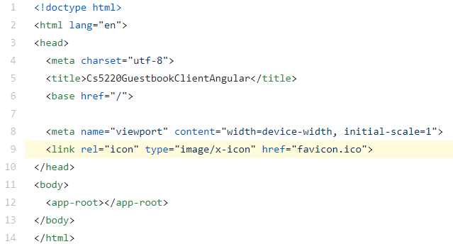
index.html
The "single page" in SPA
The page that hosts all the components such as <app-root>

Slide 32
NgModule: The Angular Module System …
The one-file-per-module approach of CommonJS/ES6 is limiting
file
file
file
file
file
file
file
file

Slide 33
NgModule: The Angular Module System
A NgModule group multiple files (i.e. components, services, and so on) into one module
file
file
file
file
file
file
file
file
NgModule
NgModule

Slide 34
@NgModule …
Each module must export a class that is decorated with @NgModule
declarations: components/directives/pipes that belong to this module
imports: modules which this module depends on
exports: components/directives/pipes that can be used by other modules
providers: injectable objects (usually services) provided by this module
bootstrap: the component(s) to load when this module is used to bootstrap (i.e. to start) an application

Slide 35
About NgModule
declarations and exports deal with components/directives/pipes, i.e. things used in templates
components/directives/pipes can be "private"
services are always "public"
imports deals with modules
imports vs import

Slide 36
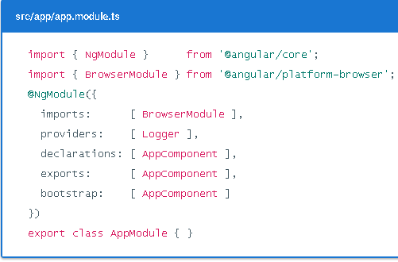
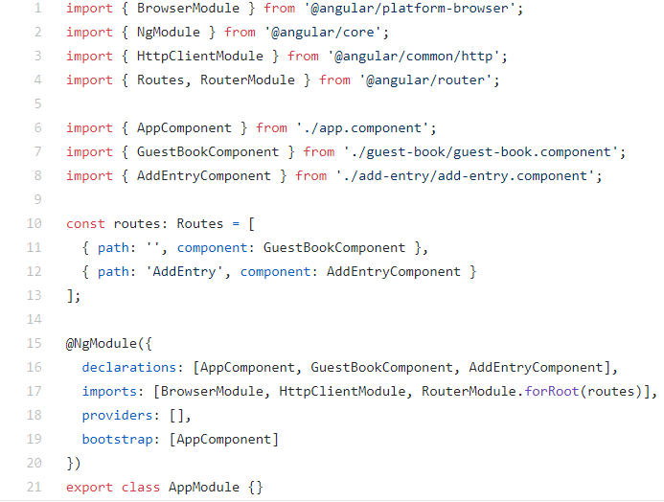
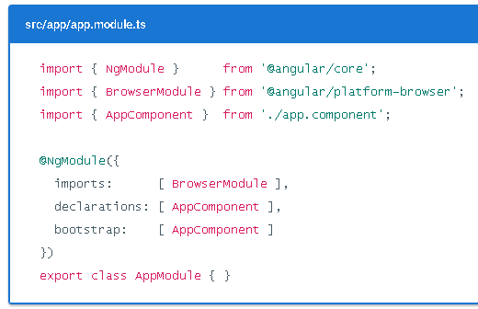
About NgModule

Slide 37
Bootstrap An Application
main.ts :
bootstrapModule(AppModule)
app.module.ts :
bootstrap: [AppComponent]
app.component.html :
<app-guest-book>
GuestBookComponent

Slide 38
Component
User-defined tags as opposed to standard HTML tags like <button>
Appearance: HTML and CSS
Behavior: TypeScript
@ Component
selector: name of the tag
templateUrl or template
styleUrls or styles
More options

Slide 39
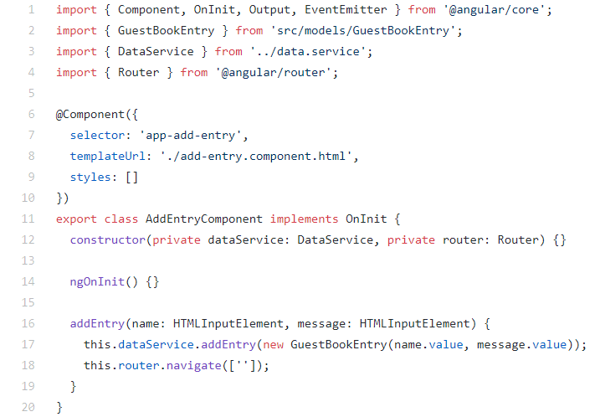
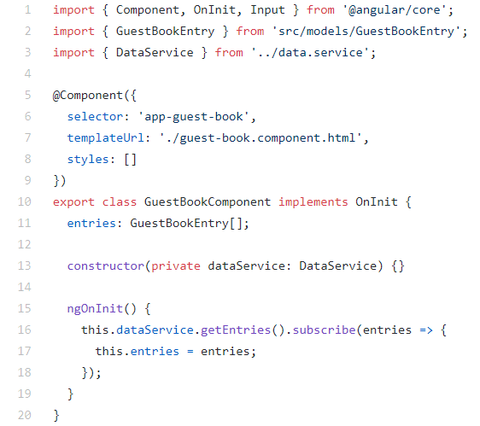
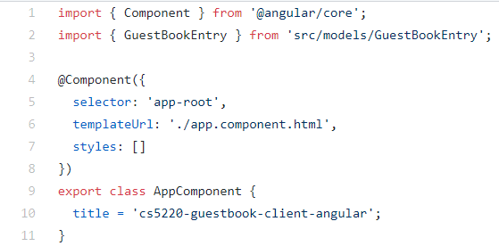
Components - Example

Slide 40
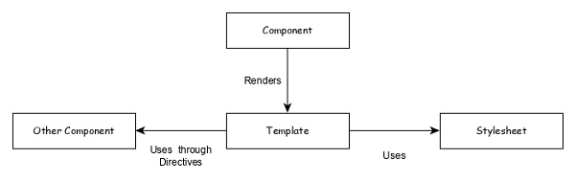
Component

Slide 41
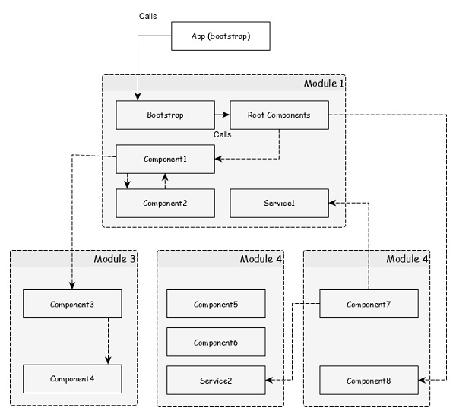
Modules Architecture

Slide 42
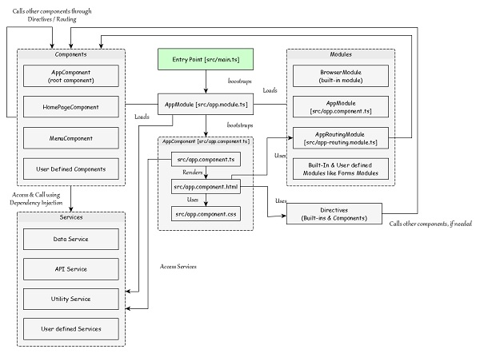
Angular Application Architecture

Slide 43
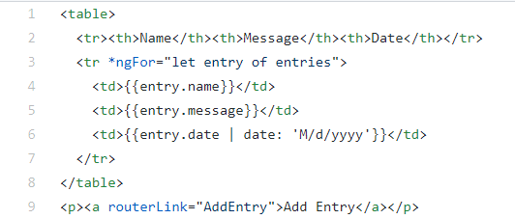
Create A New Component guest-book
ng generate component <name>
Generated files
Naming conventions for components
Tags and files
Classes and methods

Slide 44
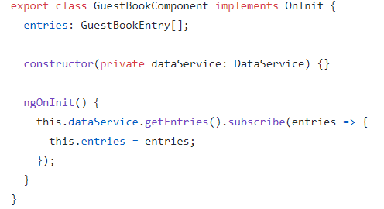

GuestBook – Data
Data model class
ngOnInit() is one of the component lifecycle hooks called after the component is constructed
Code suggestion and auto import in Visual Studio Code
Notes:
A component has a lifecycle managed by Angular.
Developers can tap into key moments in that lifecycle by implementing one or more of the lifecycle hook interfaces in the Angular core library.
Each interface has a single hook method whose name is the interface name prefixed with ng. For example, the OnInit interface has a hook method named ngOnInit() that Angular calls shortly after creating the component:

Slide 45
GuestBook – Display
Properties of a component class can be accessed directly in the component template
Interpolation: {{}}
Directive: ngFor
Pipe: date

Slide 46
Directive
Angular templates are dynamic. When Angular renders them, it transforms the DOM according to the instructions given by directives.
Encapsulated DOM-related logic that can be used to compose user interface
Types of directives
Component (i.e. directive with a view)
A component is a directive-with-a-template;
a @Component decorator is actually a @Directive decorator extended with template-oriented features.
Structural directive, e.g. ngIf, ngFor, ngSwitch
Attribute directive, e.g. ngStyle and ngClass

Slide 47
ngFor
<div *ngFor="let entry of entries">
{{entry.name}}
</div>
Property
<div *ngFor="let entry of entries; let index = index">
{{index}}. {{entry.name}}
</div>
Variable
Variable can have any name
Properties: index, first, last, even, odd

Slide 48
ngIf
<p *ngIf="entries.length == 0">
No entries yet.
</p>
<p *ngIf="entries.length == 0; else hasEntries">
No entries yet.
</p>
<ng-template #hasEntries>
<p>There are some entries.</p>
</ng-template>
Name of a
element

Slide 49
ngSwitch
<div [ngSwitch]="day">
<span *ngSwitchCase="1">Monday</span>
<span *ngSwitchCase="2">Tuesday</span>
<span *ngSwitchCase="3">Wednesday</span>
<span *ngSwitchCase="4">Thursday</span>
<span *ngSwitchCase="5">Friday</span>
<span *ngSwitchDefault>Weekend</span>
</div>

Slide 50
ngStyle
An object
<p [ngStyle]="{color: 'red', background: 'yellow'}">
Some text
</p>
<p [style.color]="'blue'">hello</p>
A string

Slide 51
ngClass
CSS classes:
.red { color: red; }
.yellow { background: yellow; }
<p [ngClass]="'red'">Some text</p>
<p [ngClass]="['yellow', 'red']">Some text</p>
<p [ngClass]="{yellow: true, red: false}">Some text</p>

Slide 52
Pipes
Chain-able formatting operators that can be applied to expressions
{{entry.date | date:'M/d/yyy'}}
{{3.1415 | number:'1.2-2' | currency:'USD'}}

Slide 53
The Component Hierarchy
AppComponent

Slide 54
Example
App
Component
GuestBook
Component
AddEntry
Component

Slide 55
Pass Data from Parent to Child
guest-book.component.ts:
@Input() entries: GuestBookEntry[];
app.component.html:
<app-guest-book [entries]="entries">
An input property in the child component
A property in the current component

Slide 56
AddEntryComponent Template
A variable in the view representing
the current element
Name: <input type="text" #name> <br>
Message: <input type="text" #message> <br>
<button (click)="addEntry(name, message)">Add</button>
Event
Event handler in the component

Slide 57
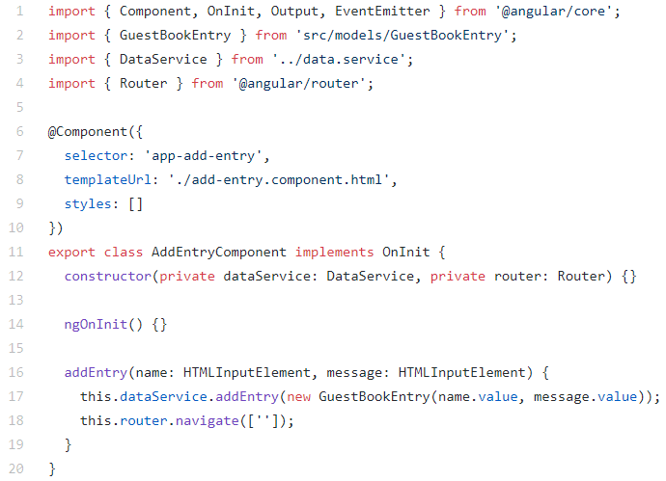
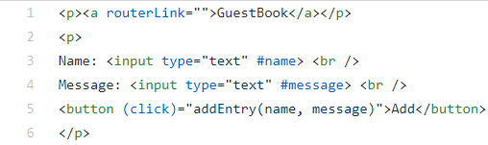
AddEntryComponent Code
Angular is still JavaScript
DOM events like click
DOM elements like HTMLInputElement
Event handler
return false to stop
event propagation

Slide 58
Pass Data from Child to Parent …
add-entry.component.ts:
@Ouput() entryAdded: EventEmitter<GuestBookEntry>
= new EventEmitter<GuestBookEntry>();
this.entryAdded.emit(
new GuestBookEntry(name.value, message.value));

Slide 59
… Pass Data from Child to Parent
app.component.html:
<app-add-entry (entryAdded)="addEntry($event)">
app.component.ts:
addEntry(entry: GuestBookEntry): void {
this.entries.push(entry);
}

Slide 60
To Component Or Not To Component
Putting everything inside one component seems to make coding easier (i.e. no need to pass data between components), so when is it better to create more components??

Slide 61
Angular: Routing

Slide 62
The Need for Routing
Usually we have different pages in a web application
How do we have different "pages" in a SPA?
Home
About
Login

Slide 63
Angular Routing
Load different components based on different URL
About
Component
Home
About
Login
Login
Component
HomeComponent
AppComponent

Slide 64
Add A Routing Module
The routing option of ng new
Add an AppRoutingModule
Import the routing module in AppModule
Add a <router-outlet> in App component template, which is a placeholder for the components to be loaded.

Slide 65
AppRoutingModule
import { NgModule } from '@angular/core';
import { Routes, RouterModule } from '@angular/router';
const routes: Routes = [];
@NgModule({
imports: [RouterModule.forRoot(routes)],
exports: [RouterModule]
})
export class AppRoutingModule { }

Slide 66
Routes
Routes specify the mappings between paths and components, e.g.
const routes: Routes = [
{ path: 'about', component: AboutComponent },
{ path: 'login', component: LoginComponent }
];

Slide 67
RouterModule
RouterModule.forRoot(routes) returns a RouterModule that is configured with routes
AppRoutingModule imports this module, then exports it so the rest of the application can use it
You can specify routing directly in AppModule, but using an AppRoutingModule is recommended (for centralizing route management in large applications)

Slide 68
The forRoot() Convention
forRoot() returns a module that should be imported by the root module (i.e. the module used for bootstrapping the application)
Use forChild() if you want to add routing to a feature module

Slide 69
Basic Routing
const routes: Routes = [
{ path: 'block1', component: Block1Component },
{ path: 'block2', component: Block2Component }
];
In template:
<a routerLink="block1">Block 1</a>
<a routerLink="block2">Block 2</a>

Slide 70
Why routerLink instead of href?
See the difference using Chrome's Developer Tools (Network tab)
Clicking on a routerLink does NOT send a request – the address URL is changed through HTML5 history API

Slide 71
routeLink as @Input
Link is hard-coded in template
<a routerLink="block1">Block 1</a>
<a [routerLink]="'block1'">Block 1</a>
<a [routerLink]="['block1']">Block 1</a>
Allow setting link with dynamic data from code

Slide 72
Route Segments
<a routerLink="user/bob">Bob</a>
<a [routerLink]="'user/bob'">Bob</a>
<a [routerLink]="['user', 'bob']">Bob</a>
<a [routerLink]="['user', name]">{{name}}</a>

Slide 73
Wildcard Route
const routes: Routes = [
{ path: 'about', component: AboutComponent },
{ path: 'login', component: LoginComponent },
{ path: '**', component: PageNotFoundComp}
];
Catch un-matched routes and display a PageNotFound page (i.e., component)
Route order matters so make sure the wildcard route is listed last

Slide 74
Navigate to Route in Code
Example: click a button in Block1 to go to Block2
class Block1Component {
constructor(private router: Router) {}
goToBlock2(): boolean {
this.router.navigate( ['block2'] );
return false;
}
}

Slide 75
Attach Information To Route
Path parameters, e.g. /user/:id
Matrix parameters, e.g. /user;fn=John;ln=Doe
Query parameters, e.g. /user?id=
Path fragment, e.g. /user#profile

Slide 76
Specify Route Parameters
const routes: Routes = [
{ path: 'block1/:id', component: Block1Component }
];
In template:
<a routerLink="block1/1">Block 1</a>
<a [routerLink]="['block1', 1]">Block 1</a>
In component class:
this.router.navigate(['block1', 1]);

Slide 77
Specify Matrix Parameters
<a [routerLink]="['block1',{x:10, y:20}]''>
this.router.navigate([ 'block1',
{x:10, y:20}
]);

Slide 78
Dependency Injection
Things to inject: services and data
Declare in providers of NgModule
Inject in constructors

Slide 79
Dependency Injection: Providers
Type Token
providers: [
{ provide: UserService, useClass: UserService },
{ provide: 'SECRET', useValue: 'abcd' }
]
String Token
providers: [
UserService, { provide: 'SECRET', useValue: 'abcd' }
]

Slide 80
Dependency Injection: Inject
Class HomeComponent {
constructor(
private UserService: userService,
@Inject('SECRET') private secret: string
) {}
}

Slide 81
Angular : Services

Slide 82
Angular Services
Implement business logic of an application
Made available to other parts of the application via dependency injection
Decorated with @Injectable
Declared in providers of @NgModule
Injected into constructors

Slide 83
Example: GuestBook
App
Component
GuestBook
Component
Data
Service
REST
API
<router-outlet>
AddEntry
Component

Slide 84
Changes to AddEntry Form …
Name: <input type="text" #name>
Message: <input type="text" #message>
<button (click)="addEntry(name,message)">
Add
</button>

Slide 85
… Changes to AddEntry Form
Name: <input type="text" name="name"
[(ngModel)]="entry.name">
Message: <input type="text" name="message"
[(ngModel)]="entry.message">
<button (click)="addEntry()">Add</button>
[(ngModel)] creates a 2-way binding between a form field and a property in the component class

Slide 86
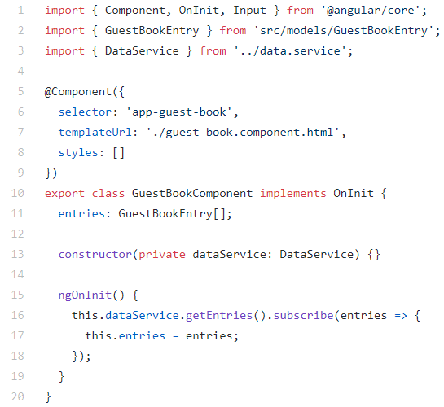
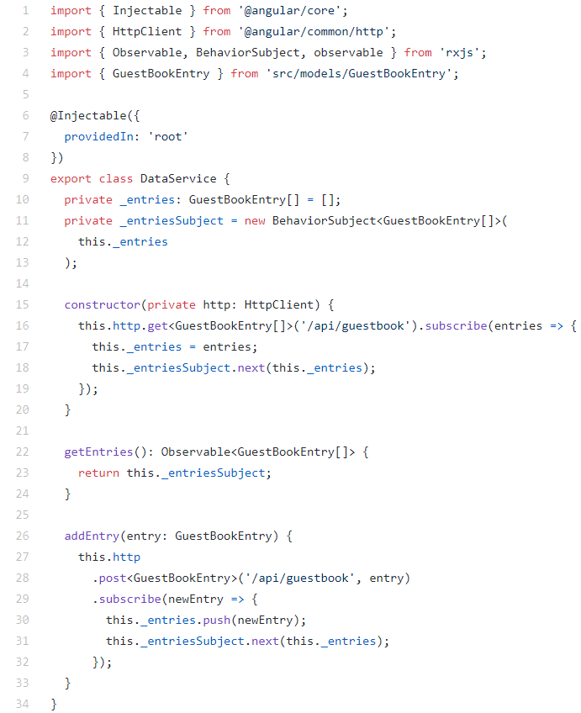
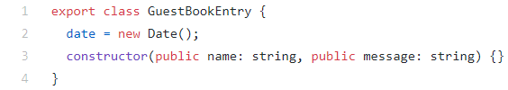

Slide 87
Create A Remote Data Service
Use Angular CLI to generate a service
Naming conventions
Add it to AppModule
Inject it to component classes

Slide 88
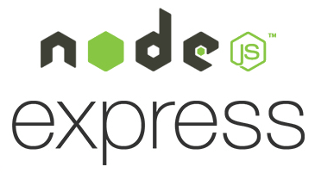
Use HttpClient to Access REST API
Import HttpClientModule from @angular/common/http
Inject HttpClient to code that needs to make API calls
Use HttpClient API, e.g. get

Slide 89
Set Up Proxy During Development …
NG Server at
Port 4200
Angular
App
REST
API Call
Browser
API Server at
Port 3000 (or 8080)
For security reasons,
browsers enforce same-origin
policy on XMLHttpRequest
Localhost

Slide 90
… Set Up Proxy During Development …
NG Server at
Port 4200
Angular
App
REST
API Call
Browser
API Server at
Port 3000 (or 8080)
Localhost

Slide 91
… Set Up Proxy During Development
Create proxy configuration file proxy.conf.json, e.g.
{
"/api": {
"target": "http://localhost:3000",
"secure": false
}
}
For Connect to Express API, change start script in package.json
ng serve --proxy-config proxy.conf.json

Slide 92
Deploy Angular App
Build Angular App: ng build --prod
The /dist folder will contain the files to be deployed
Because Angular is just JavaScript, HTML, and CSS, an Angular app can be served as static resources as part of a web application or service

Slide 93
Thank you!

